Slide 2
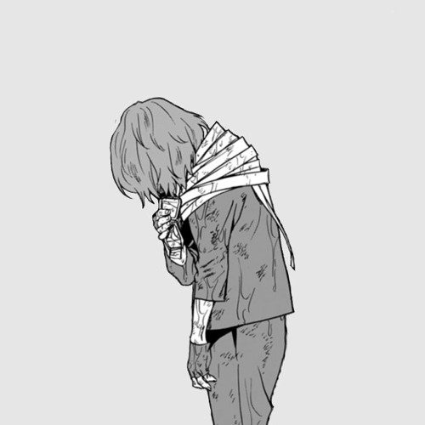
“I Wish I had never been born!”

Slide 3
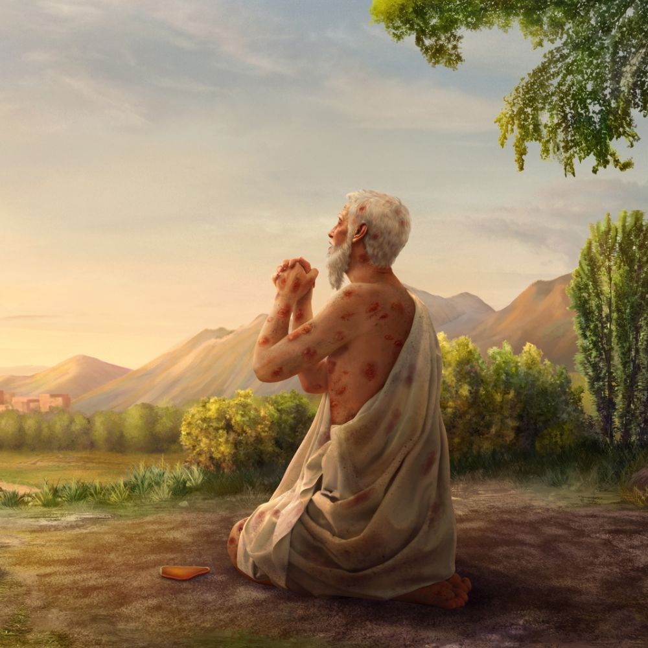
Job – 3:1-19
“Job opened his mouth and cursed the day of his birth.”
"May the day perish on which I was born….”
"Why did I not die at birth? Why did I not perish when I came from the womb?”
“Or why was I not hidden like a stillborn child, Like infants who never saw light?”

Slide 4

Day of judgment
Hebrews 9:27 “appointed for men to die once, but after this the judgment”
Acts 17:30,31 “He has appointed a day on which He will judge the world in righteousness by the Man whom He has ordained”

Slide 5
If you die lost, you will wish you were never born:
Because of the Separation – Isaiah 59:1,2
SIN Separates MAN from GOD!
You can NEVER be in Gods presence AGAIN!
Revelation 21:8 “cowardly, unbelieving, abominable, murderers, sexually immoral, sorcerers, idolaters, and all liars shall have their part in the lake which burns with fire and brimstone”
Revelation 14:13 “Blessed are the dead who die in the Lord”
Luke 16:26-31; Romans 1:16

Slide 6
If you die lost, you will wish you were never born:
Because of the Pain – eternal fires of HELL!
Luke 16:23 “being in torments in Hades”
Matthew 25:41 “the everlasting fire prepared for the devil and his angels."
A Place Filled with PAIN and GNASHING OF TEETH!
Matthew 25:30; Revelation 14:11 “they have no rest”
Mark 9:43-46 “their worm does not die and the fire is not quenched”

Slide 7
If you die lost, you will wish you were never born:
Because of the Duration – Punishment of HELL is ETERNAL!
Matthew 25:46 “everlasting punishment."
The LENGTH of the PUNISHMENT in Matthew 25:46 is the SAME as the LENGTH OF LIFE!
“Where will you spend eternity?”
ETERNITY will NEVER be SPENT! It will ALWAYS BE!
WHERE WILL YOU BE IN ETERNITY?

Slide 8
If you die lost, you will wish you were never born:
Because of the LOSS – the most PRECIOUS POSSESION they have EVER OWNED! Their OWN SOULS!
Mark 8:36,37 “what will a man give in exchange for his soul?"
Born to “GLORIFY GOD IN OUR BODIES!" 1 Corinthians 6:20
God desires you to OBEY HIM and LIVE ETERNALLY – 2 Peter 3:9

Slide 9
If you die lost, you will wish you were never born:
Because they LOST HEAVEN!
1 Peter 1:3-5 “an inheritance incorruptible and undefiled and that does not fade away, reserved in heaven for you”
John 14:1-6 “In My Father's house are many mansions; if it were not so, I would have told you. I go to prepare a place for you. 3 "And if I go and prepare a place for you, I will come again and receive you to Myself; that where I am, there you may be also.”

Slide 10

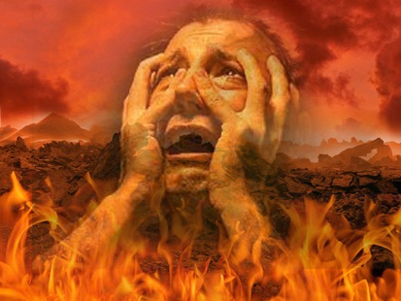
If you die lost, you will wish you were never born:
Because they have LOST ALL HOPE!
Romans 8:24 “saved in hope”
“As long as there is LIFE there is HOPE.”
Means NOTHING to those in HELL!

Slide 11
You are already born
As long as you remain in this life, there is opportunity for you to CHOOSE where you will BE in ETERNITY!
IF you have not obeyed the gospel of Christ and come INTO CHRIST (and you are WISE) you will use this opportunity to OBEY THE GOSPEL!
Eternity will be a time of PRAISE and THANKSGIVING IF, and ONLY IF you die IN CHRIST, as a FAITHFUL CHILD OF GOD!

Slide 12
How can you get into christ now?
Galatians 3:26-27 NKJV 26 “For you are all sons of God through faith in Christ Jesus. 27 For as many of you as were baptized into Christ have put on Christ.”
Once IN CHRIST and don’t remain FAITHFUL to Him, all HOPE is not LOST! Acts 8:22-24

Slide 13
A serious & soul-searching question:
IF you died tonight, would you enter eternity wishing you had never been born?
OR would you be thankful for the day of your birth?

